Slide 1


INSTITUTE : UIE
DEPARTMENT : CSE
Bachelor of Engineering (Computer Science & Engineering)
WEB AND MOBILE SECURITY (Professional Elective-I)
(20CST/IT-333)
TOPIC OF PRESENTATION:
Network topologies and DMZ.
DISCOVER . LEARN . EMPOWER

Slide 2
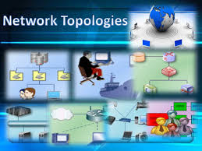
Lecture Objectives
In this lecture, we will discuss:
Introduction to Network topologies and DMZ

Slide 3
Network Topology
Computer network topology is the way various components of a network (like nodes, links, peripherals, etc) are arranged. Network topologies define the layout, virtual shape or structure of network, not only physically but also logically. The way in which different systems and nodes are connected and communicate with each other is determined by topology of the network.

Slide 4
Topology can be physical or logical
Physical Topology is the physical layout of nodes, workstations and cables in the network.
Logical topology is the way information flows between different components.

Slide 5
Simple Physical Topologies
Physical topology: physical layout of nodes on a network
Four fundamental shapes:
Bus
Ring
Star
Mesh
May create hybrid topologies
Topology integral to type of network, cabling infrastructure, and transmission media used

Slide 6
Why we need a topology
Choosing one topology over another can impact :
type of equipment the network needs
capabilities of the equipment
network’s growth
way a network is managed

Slide 7
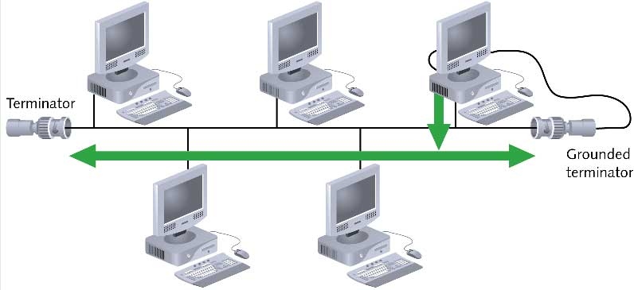
Bus

Slide 8
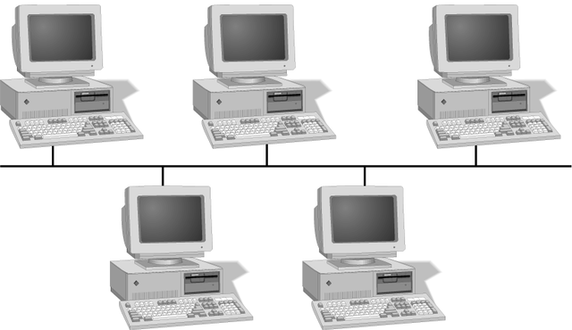
Simple Physical Topologies
A Bus topology consists of a single cable—called a backbone— connecting all nodes on a network without intervening connectivity devices

Slide 9

Bus (continued)
Devices share responsibility for getting data from one point to another
Terminators stop signals after reaching end of wire
Prevent signal bounce
Inexpensive, not very scalable
Difficult to troubleshoot, not fault-tolerant

Slide 10
Bus
Advantages
Disadvantage
Works well for small networks
Easy to install
Relatively inexpensive to implement
Management costs can be high
Network disruption when computers are added or removed
A break in the cable will prevent all systems from accessing the network.
Difficult to troubleshoot

Slide 11
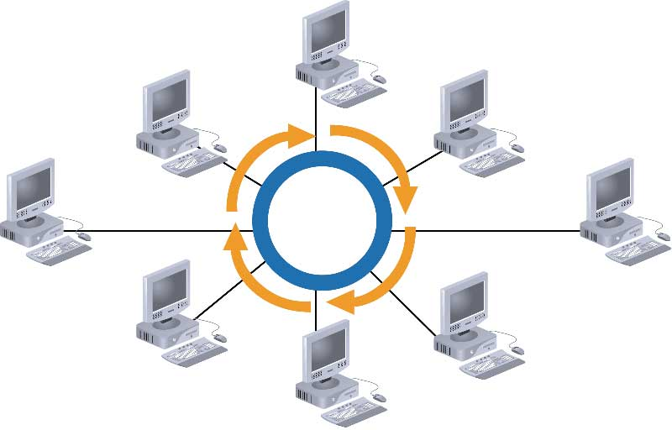
Ring

Slide 12
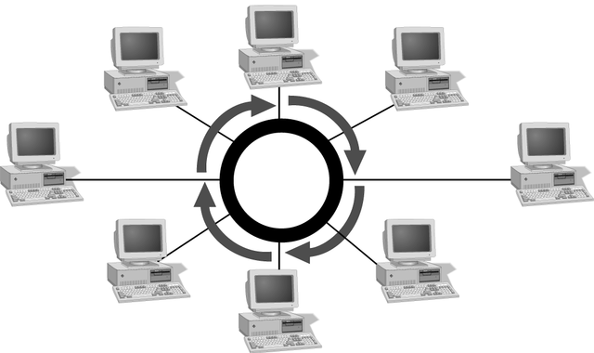
Simple Physical Topologies
Ring topology
Each node is connected to the two nearest nodes so the entire network forms a circle
One method for passing data on ring networks is token passing
Data travels around the network
Traffic flows in one direction
Slow performance
One workstation goes down; whole network goes down
Network is highly dependent

Slide 13
Ring
Advantages
Disadvantage
Cable faults are easily located, making troubleshooting easier
Ring networks are moderately easy to install
Expensive
Requires more cable and network equipment at the start
Expansion to the network can cause network disruption
A single break in the cable can disrupt the entire network

Slide 14
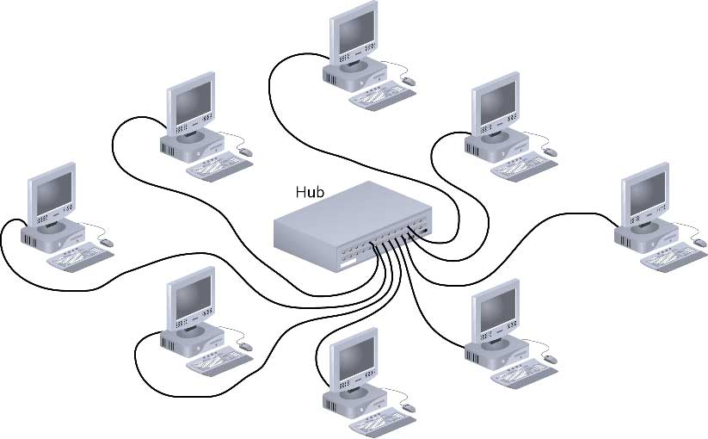
Star

Slide 15
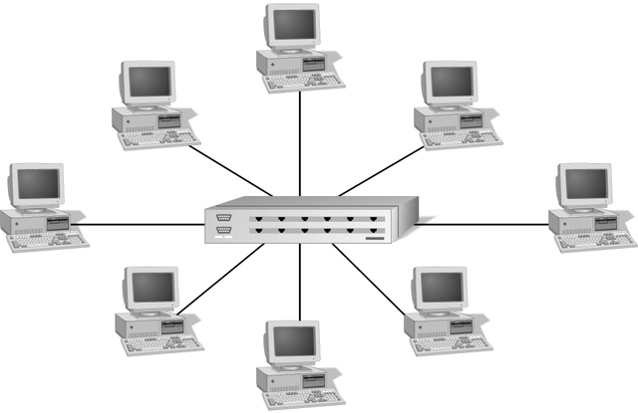
Simple Physical Topologies
Star topology
Every node on the network is connected through a central device called hub or switch.

Slide 16
Star (continued)
Any single cable connects only two devices
Cabling problems affect two nodes at most
Requires more cabling than ring or bus networks
More fault-tolerant
Easily moved, isolated, or interconnected with other networks
Scalable
Supports max of 1024 addressable nodes on logical network

Slide 17
Star
Advantages
Disadvantage
Good option for modern networks
Low startup costs
Easy to manage
Offers opportunities for expansion
Most popular topology in use; wide variety of equipment available
Hub is a single point of failure
Requires more cable than the bus

Slide 18
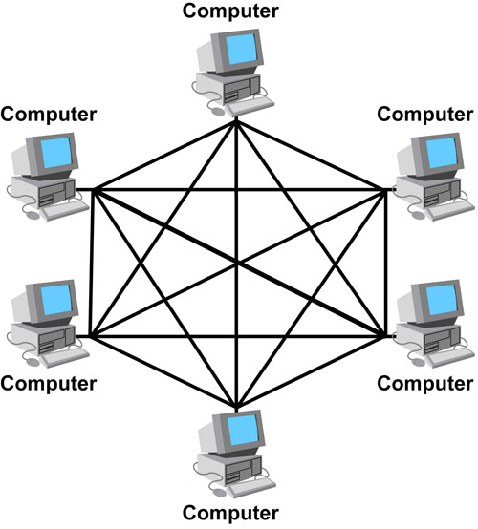
Mesh

Slide 19
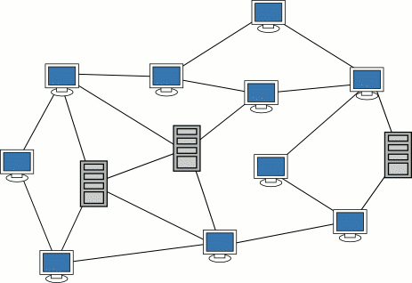
Simple Physical Topologies
Mesh Topology: Each computer connects to every other.
High level of redundancy.
Rarely used.
Wiring is very complicated
Cabling cost is high
Troubleshooting a failed cable is tricky
A variation hybrid mesh – create point to point
connection between specific network devices, often
seen in WAN implementation.

Slide 20
Mesh
Advantages
Disadvantage
Robust
There is the advantage of privacy or security
The network can be expanded without disruption to current uses
Point to point links make fault identification and fault isolation easy
Requires more cable than the other LAN topologies
Complicated implementation
Installation and reconnection are difficult.
Sheer bulk of wiring can be greater than the available space can accommodate
Expensive

Slide 21
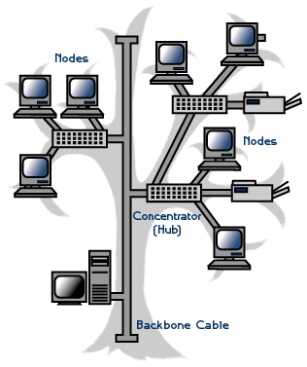
Hybrid Physical Topologies
One example of Hybrid Topology is Tree topology
Tree topology is a combination of Bus and Star topology.
It consists of groups of star-configured workstations connected to a linear bus backbone cable.
If the backbone line breaks, the entire segment goes down
An example of this network could be cable TV technology

Slide 22
Choosing a Topology
BUS
network is small
network will not be frequently reconfigured
least expensive solution is required
network is not expected to grow much
STAR
it must be easy to add/remove PCs
it must be easy to troubleshoot
network is large
network is expected to grow in the future
RING
network must operate reasonably under heavy load
higher speed network is required
network will not be frequently reconfigured

Slide 23
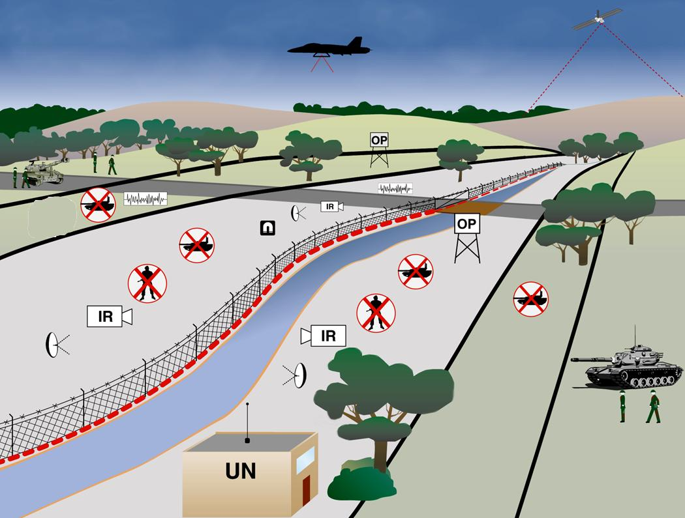
DMZ? - Demilitarized Zone
“An area in which it is forbidden to station military forces or maintain military installations.
Any area, place, or circumstance in which conflicts or hostilities are held in abeyance.” Dictionary.com

Slide 24
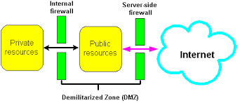
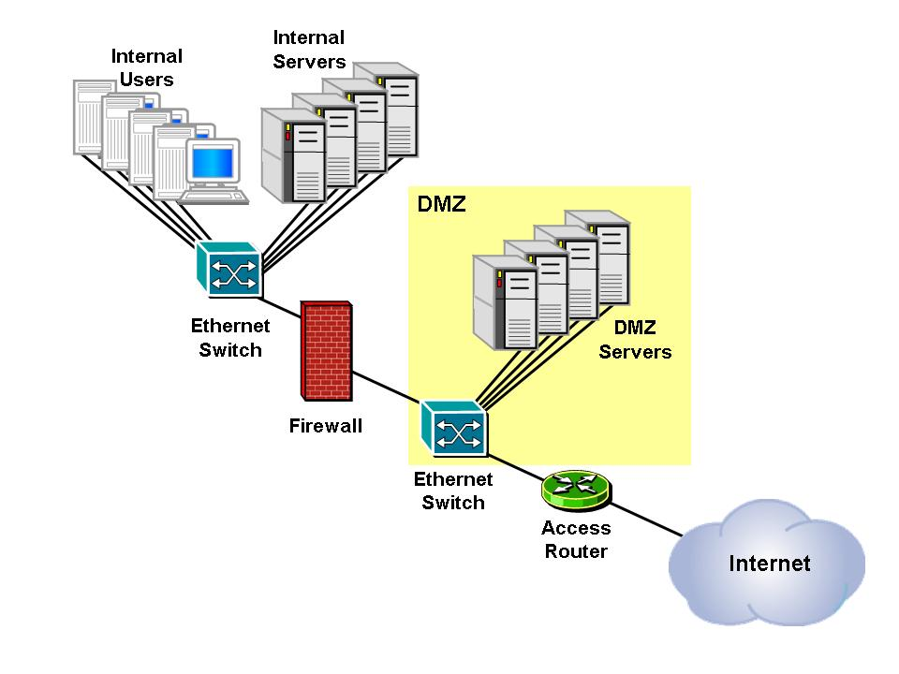
Network - DMZ

Slide 25
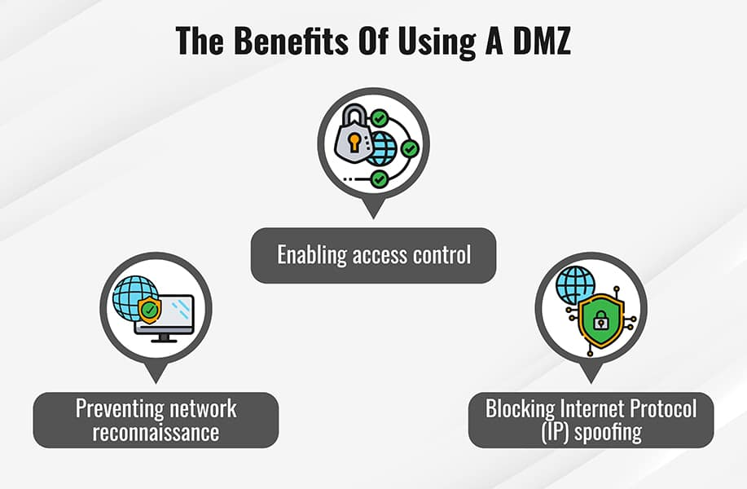

Slide 26
DMZ Design and Architecture
A DMZ is a “wide-open network," but there are several design and architecture approaches that protect it. A DMZ can be designed in several ways, from a single-firewall approach to having dual and multiple firewalls. The majority of modern DMZ architectures use dual firewalls that can be expanded to develop more complex systems.
Single firewall: A DMZ with a single-firewall design requires three or more network interfaces. The first is the external network, which connects the public internet connection to the firewall. The second forms the internal network, while the third is connected to the DMZ. Various rules monitor and control traffic that is allowed to access the DMZ and limit connectivity to the internal network.
Dual firewall: Deploying two firewalls with a DMZ between them is generally a more secure option. The first firewall only allows external traffic to the DMZ, and the second only allows traffic that goes from the DMZ into the internal network. An attacker would have to compromise both firewalls to gain access to an organization’s LAN.

Slide 27
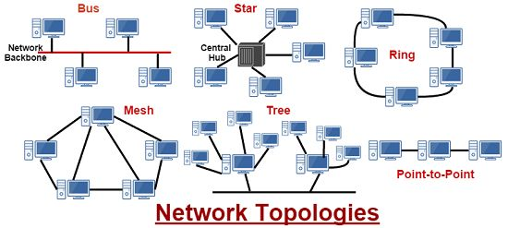

Slide 28
References:
Books:
Web Design With HTML, CSS, JavaScript and jQuery Set, 1st Edition, by Jon Duckett.
Hacking Exposed Web Applications, 3rd edition, Joel Scambray, Vincent Liu, Caleb Sima, Released October 2010, Publisher(s): McGraw-Hill
Video Lectures :
https://www.techtarget.com/searchsecurity/definition/DMZ
https://www.youtube.com/watch?v=uSKdjjw5zow
Reference Links:
1. https://www.fortinet.com/resources/cyberglossary/what-is-dmz#:~:text=A%20DMZ%20Network%20is%20a,public%20internet%20and%20private%20networks.

Slide 29

THANK YOU

